Slide 1

AJAY BINAY INSTITUTE OF TECHNOLOGY
Name : Abhishek Nayak
Regd No. : 1901206041
Branch : CSE

Slide 2
Git and Github

Slide 3
Content
Steps to Create a Repo and Upload Your Files
Disadvantages
Conclusion
End
2
4
6
8
Introduction
1
3
5
7
Advantages
Future Scope
References

Slide 4
Introduction
Git is a distributed version control system: tracking changes in any set of files, usually used for coordinating work among programmers collaboratively developing source code during software development. Its goals include speed, data integrity, and support for distributed, non-linear workflows.
GitHub is a code hosting service for software development and version control using Git. It provides the distributed version control of Git plus access control, bug tracking, software feature requests, task management, continuous integration, and wikis for every project.

Slide 5
Steps to Create a Repo and upload Files
CREATE A REPO IN GITHUB
Create a repository in GitHub and copy the remote from the given data.
INITIALISATION
Then we need to initialise the location where we are having all our files by using command (Git init).
ADDING THE FILE
Then we need to add the files by using command (Git add .) that means all the files inside that location will be added.
COMMITING THE UPDATES
If a particular task is done then we need to commit that by leaving some message by using command (Git commit –m “initial commit”).
ADD REMOTE
Then we need to add that remote URL which we have copied from GitHub to create a pipeline connection between Git and GitHub.
PUSH
When all the above steps are done we can push it by using command (Git Push origin master). Then we can see our files there in Github.

Slide 6
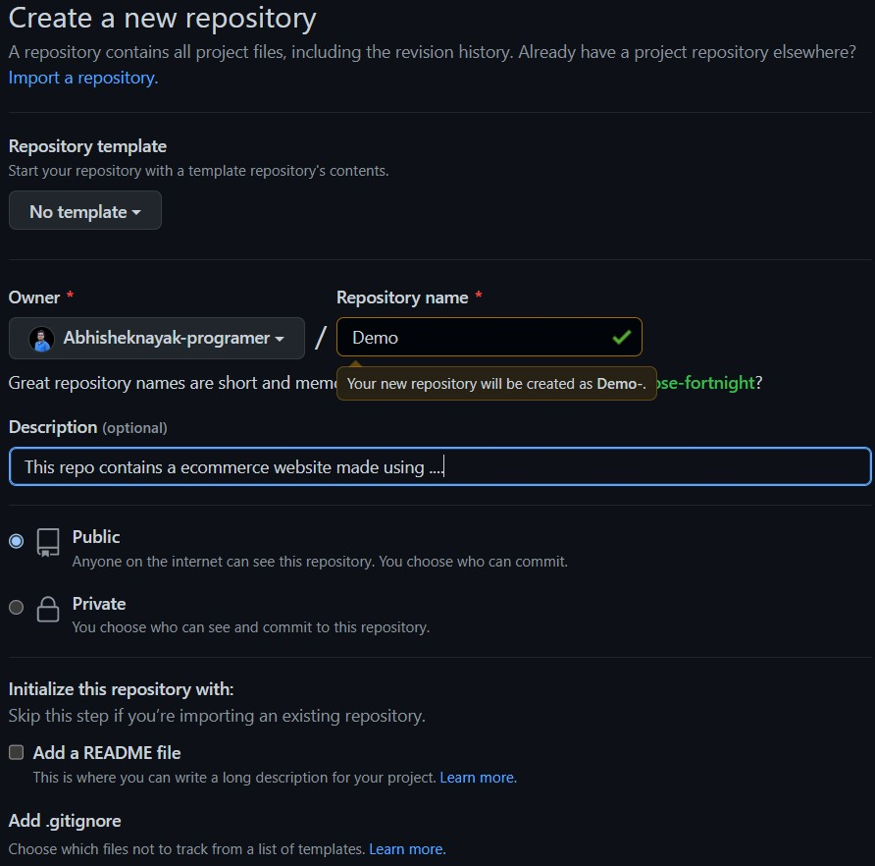
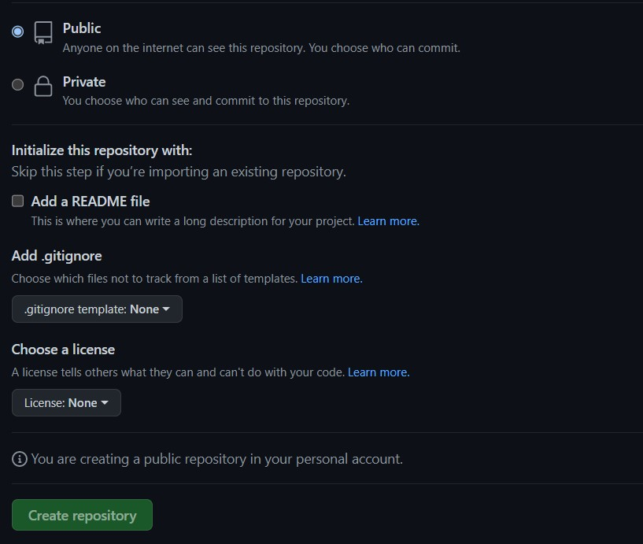
Git and GitHub Integration

Slide 7
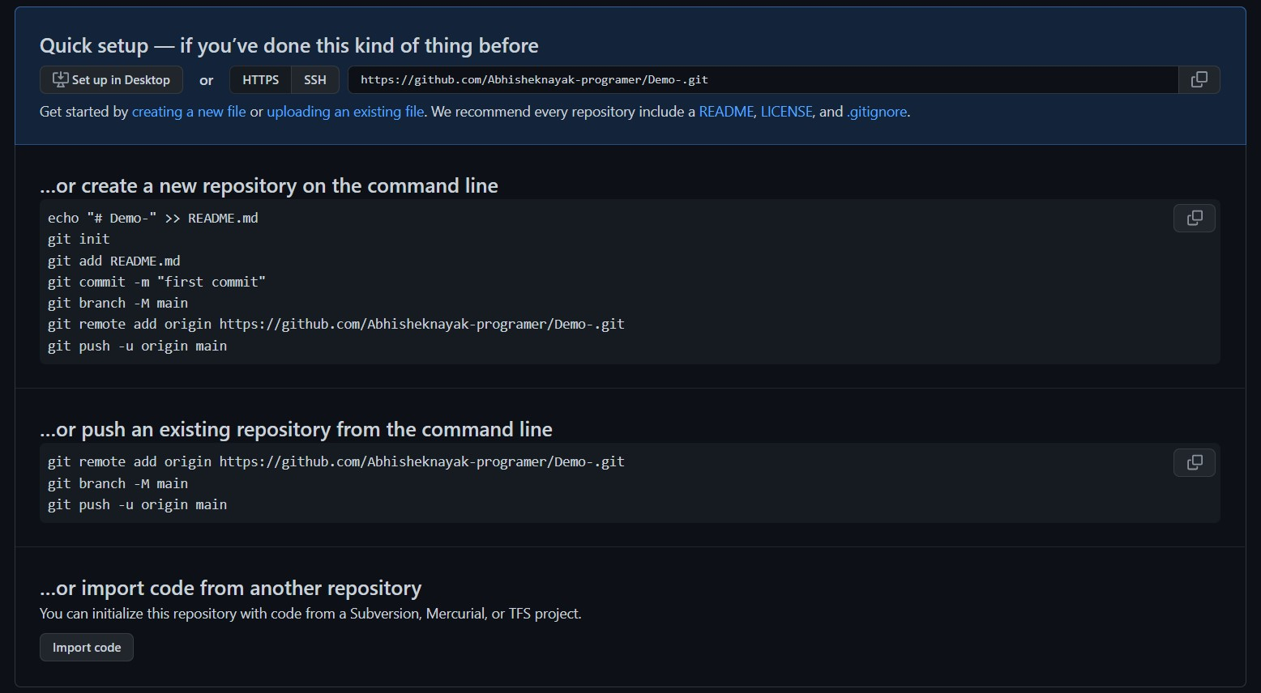

Slide 8
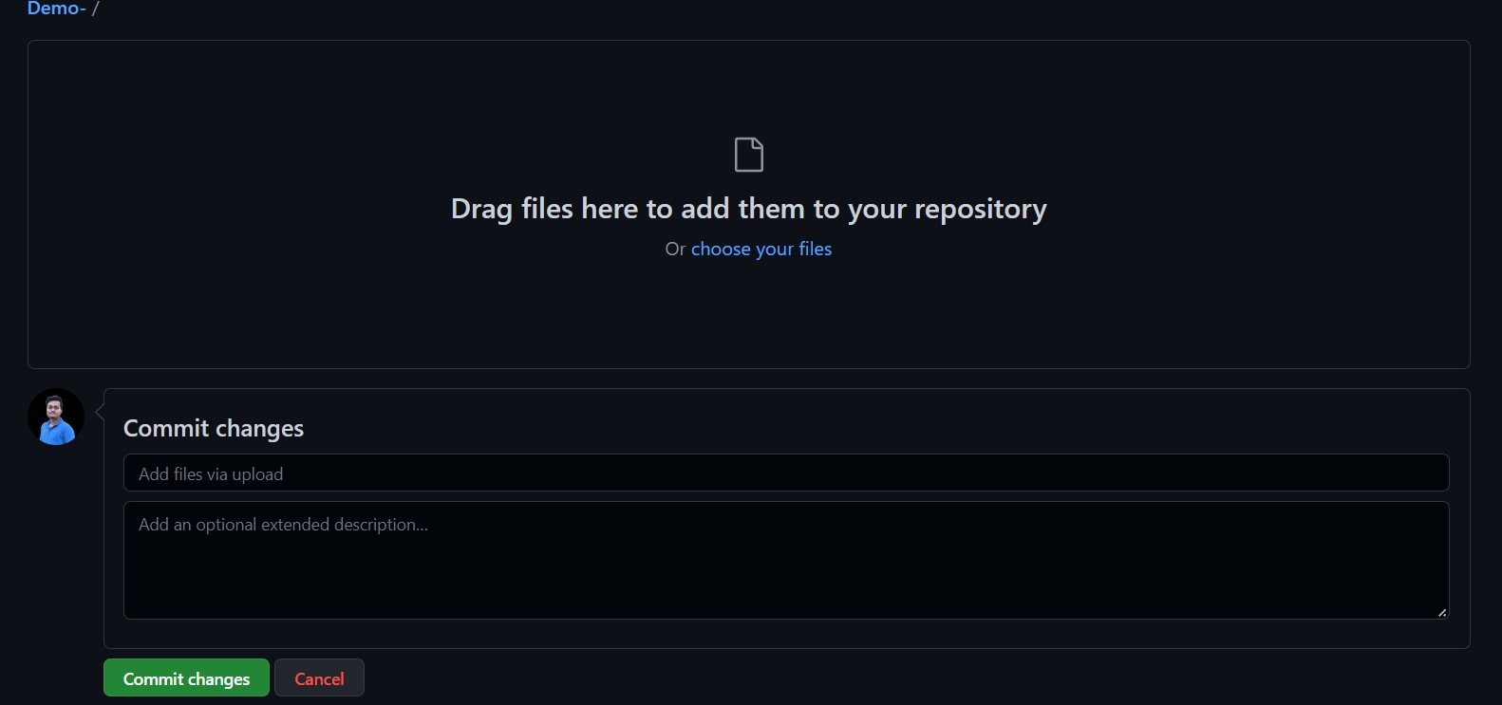

Slide 9
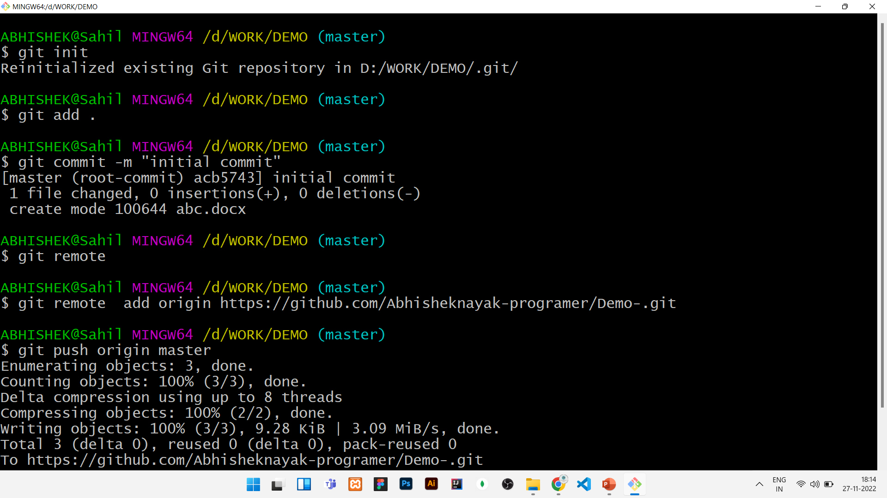

Slide 10
Advantages
Easy to use and Implement.
The user does not need to maintain and update the referenced database.
The user can get immediate location results.
No extra software or tool is required on the user side to get the results.

Slide 11
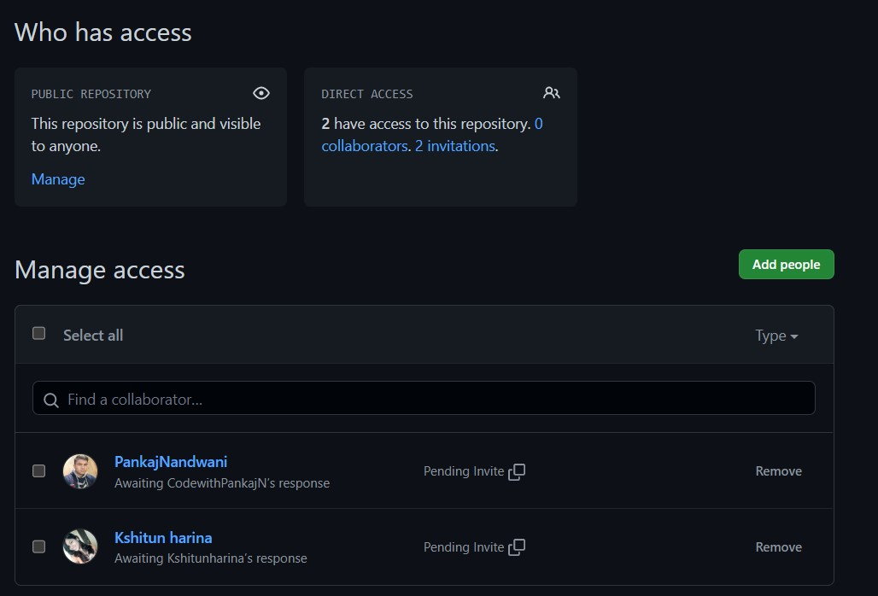

Slide 12
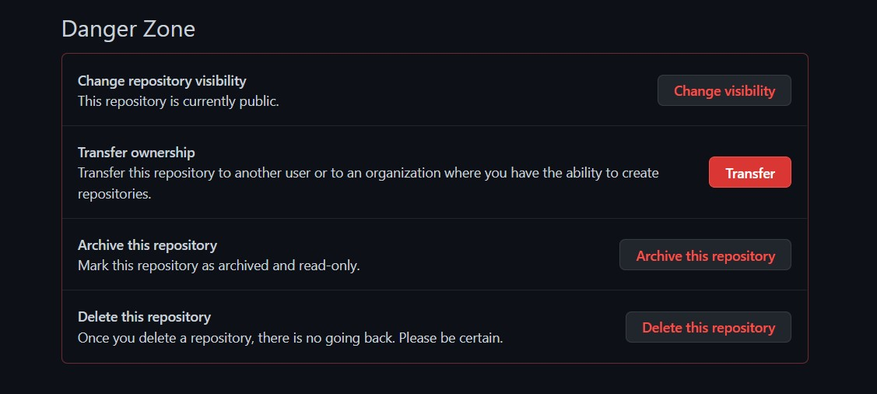

Slide 13
Disadvantages
Without Internet connection it is not possible for a user to get the desired result.
While the conversion process from coordinates to a proper location there may be a chance that the same area name or location name may be present twice or more in that state or country.

Slide 14
Future Scope
Now a day most of the websites and even applications uses this reverse geocoding techniques like Amazon, Flipkart , Google Maps, Zomato , Swiggy etc. to know the exact location of the user and send their product to that location.

Slide 15
Conclusion
So here I conclude that in future a lot of upcoming companies and startups will be using this technique to get the users exact location and perform any operation with that resulted location.

Slide 16
References
https://git-scm.com/ [ Download Git Link ]
https://github.com/ [ Used to store Files ]

Slide 17
Thank You!

